Slide 1







SUDOKU GAME
& Solver
Presented by Lockdown Group
Group Members: Sahil Raj (220150018)
Vishal (220150029)

Slide 2
Methodoloy
Approach Used
Algorithms, technologies, and tools
Results
One player game
Solution for given sudoku’s input

Slide 3
Methodology: Approach Used
Rules: Ensure you thoroughly understand the rules of Sudoku. Each row, column, and 3x3 subgrid must contain all the numbers from 1 to 9 without repetition.
Design: Before diving into coding, sketch out your game's structure. Consider how you'll represent the Sudoku grid, how users will interact with it, and what features your game will have (e.g., hints, difficulty levels).
Data Representation: Decide how you'll represent the Sudoku grid in your code. This might involve a 2D array or a more sophisticated data structure.

Slide 4
Methodology: Approach Used
Generating a Valid Puzzle: To create a Sudoku puzzle, start with a completed grid(make two copies in which one give to the user & second is used for hints and solution) and then remove numbers while ensuring the puzzle remains solvable. There are several algorithms for generating Sudoku puzzles, such as backtracking or randomized approaches.
Difficulty levels: For making different difficulty level, we remove randomly some numbers of the grid according to the level selected.

Slide 5
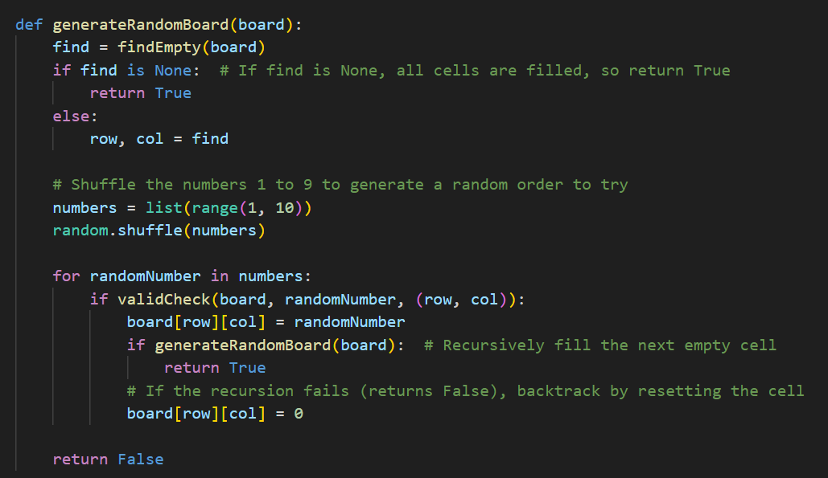
Methodology: Algorithms & technologies

Slide 6
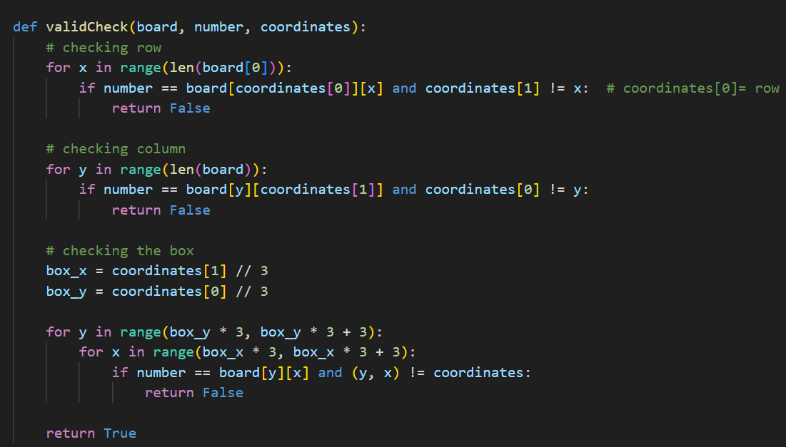
Methodology: Algorithms & technologies

Slide 7
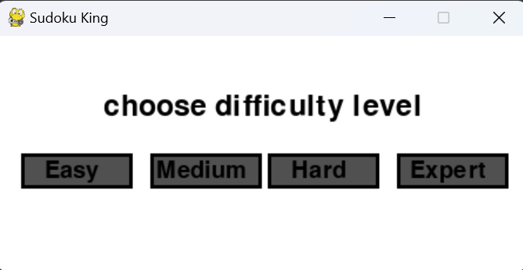
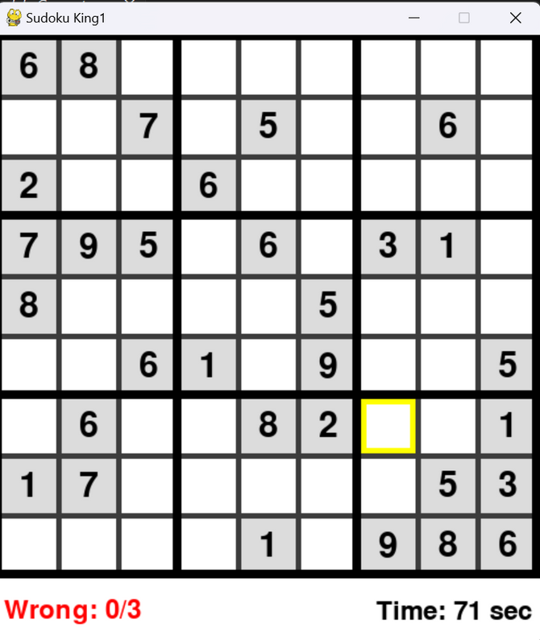
Results: One player game

Slide 8
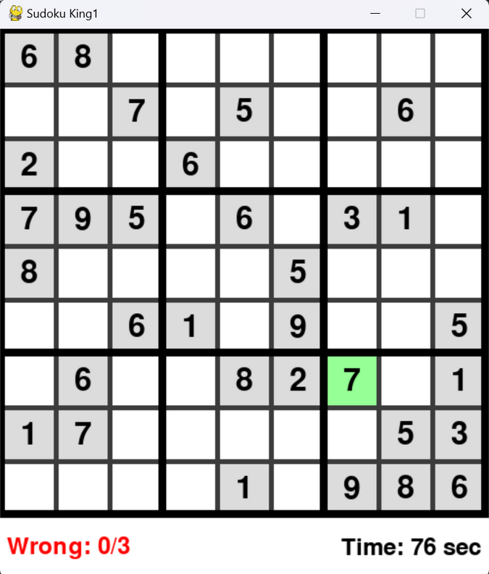
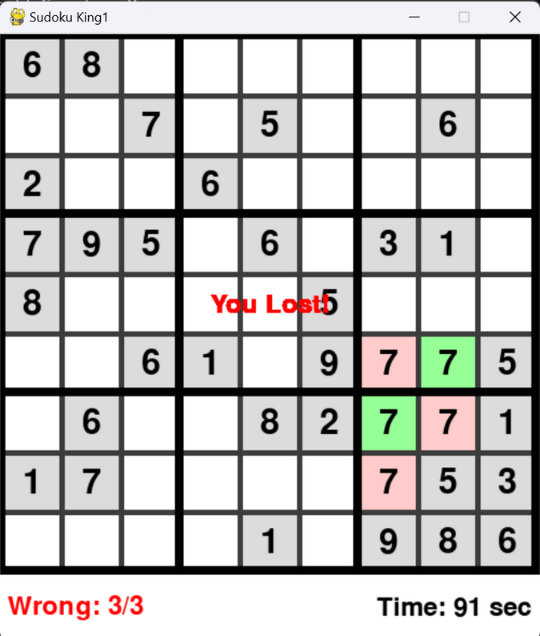
Results: One player game
Even after you lost, you can know the solution of that puzzle by pressing C button.

Slide 9
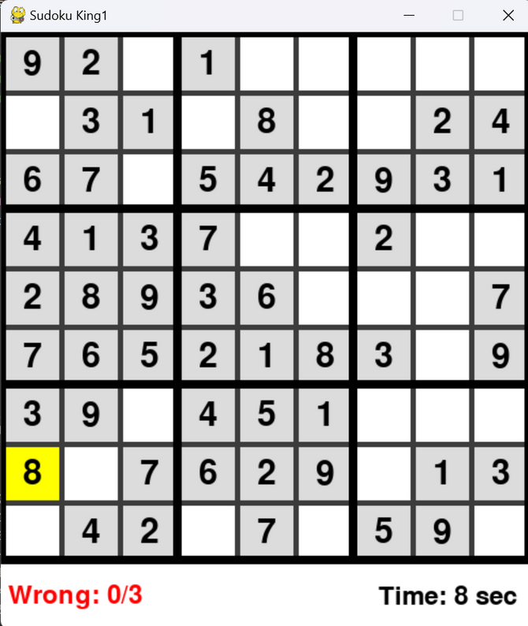
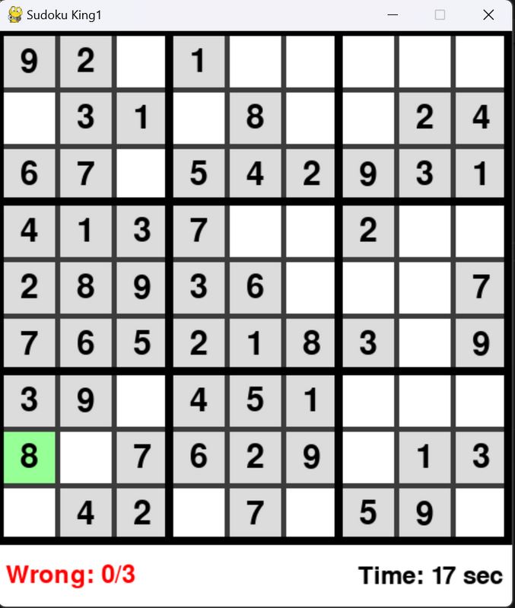
Results: One player game
For hint, press H button at particular box.

Slide 10
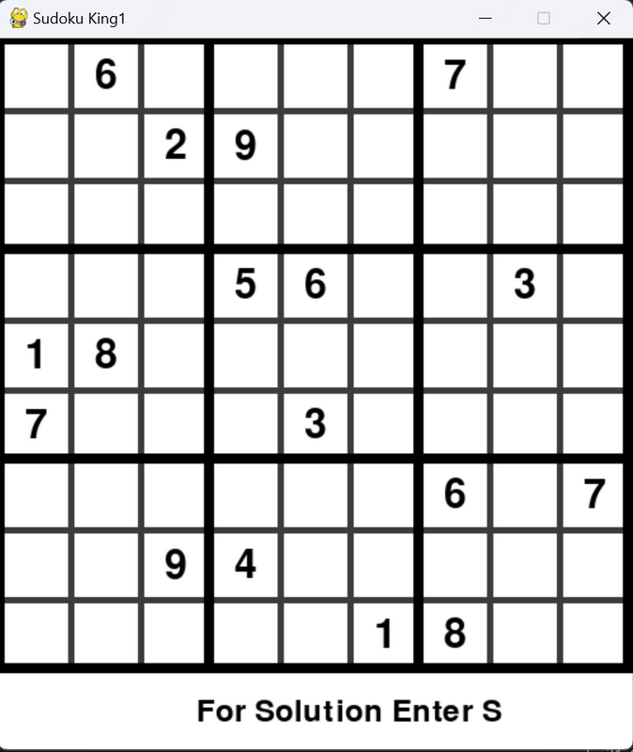
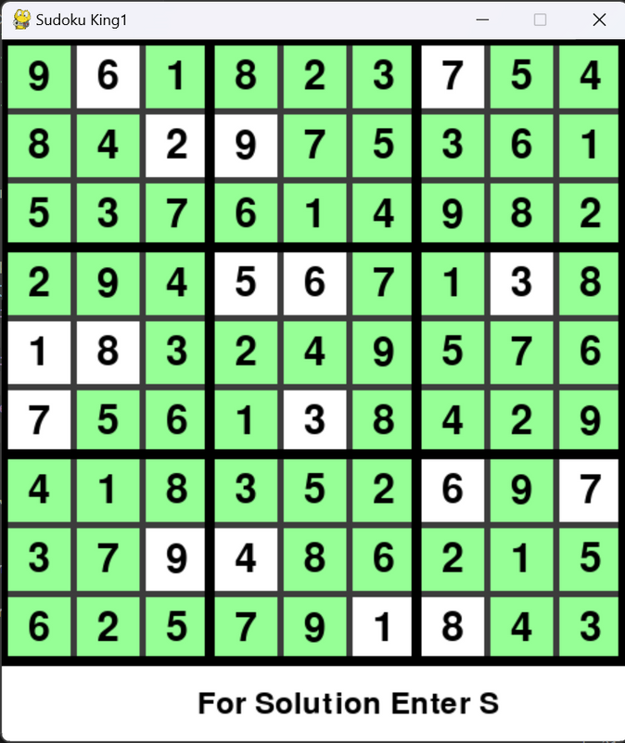
Results: Solution for given sudoku’s input

Slide 11
Thank
you

